Slide 1
Artificial Intelligence
CS370D
Prolog programming
Arithmetic in Prolog.

Slide 2
Outline:
Arithmetic in Prolog.
Arithmetic Operators and Functions.
Arithmetic Operator Examples.
Arithmetic Function Examples.
Operator Precedence in Arithmetic Expressions.
Relational Operators.
Relational Operator Examples.
Equality Operators.
  Arithmetic Expression Equality.
  Arithmetic Expression Inequality.
  Terms Identical.

Slide 3
Arithmetic in Prolog:
Prolog provides facilities for doing arithmetic using a notation similar to that which will already be familiar to many users from basic algebra.
This is achieved using the built-in predicate is
Any variables appearing in an arithmetic expression must already be bound (as a result of evaluating a previous goal) and their values must be numerical.
Examples:
?- X is 10.5+4.7*2.X = 19.9.
?- Y is 10,Z is Y+1.Y = 10,Z = 11.

Slide 4
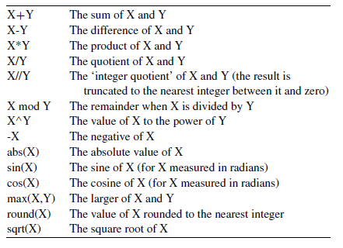
Arithmetic Operators and Functions:
The table below shows some of the arithmetic operators(+,-,* .etc) and arithmetic functions(abs,sin..etc) available in Prolog.

Slide 5
Arithmetic Operator Examples:
Examples:
?- X is 10/4.
X = 2.5.
?- X is 10//4.
X= 2.
?- X is 10,Y is -X-2.
X = 10,Y= -12.
?- X is 30,Y is 5,Z is X+Y+X*Y.
X = 30,Y = 5,Z = 185.

Slide 6
Arithmetic Operator Examples: (cont)
Examples:
?- X is 7,X is 6+1.X=7.
?- 10 is 7+13-11+9. false.
?- 18 is 7+13-11+9. true.
?- X is 10,X is X+1. false.
?- X = 1 + 2. X = 1+2.
?- 1+2 = 2+1.false.
?- 1+A = B+2.A = 2,B = 1.

Slide 7
Arithmetic Function Examples:
Examples:
?- X is sqrt(36).
X=6.0.
?- Y is max(4,5) .
Y=5.
?- 9 is max(9,11).
false.

Slide 8
Operator Precedence in Arithmetic Expressions:
Operators with relatively high precedence such as * and / are applied before those with lower precedence such as + and -.
Operators with the same precedence (e.g. + and -, * and /) are applied from left to right.
Bracketed expressions () are always evaluated first.

Slide 9
Relational Operators:
The operators =:=,=\=,<,=<,>,>= are a special type known as relational operators.
They are used to compare the value of two arithmetic expressions.
The goal succeeds if the value of the first expression is equal to, not equal to, greater than, greater than or equal to, less than or less than or equal to the value of the second expression, respectively.

Slide 10
Relational Operator Examples:
Examples:
?- 90=<9.
false.
?- 88+15-3>110-5*2.
false.

Slide 11
Equality Operators:
There are three types of relational operator for testing equality and inequality available in Prolog:
  Arithmetic Expression Equality =:=
  Arithmetic Expression Inequality =\=
  Terms Identical ==

Slide 12
Arithmetic Expression Equality:
E1=:=E2 succeeds if the arithmetic expressions E1 and E2 evaluate to the same value.
Examples:
?- 6+4=:=6*3-8. true.
?- sqrt(36)+4=:=5*11-4.false.
?- 1+2 =:= 2+1.true.
?- 2+2 =:= 1+3. true.

Slide 13
Arithmetic Expression Inequality:
E1=\=E2 succeeds if the arithmetic expressions E1 and E2 don’t evaluate to the same value.
Example:
?- 10=\=8+3.
true.
?- 3+4=\=3+4.
false.

Slide 14
Terms Identical:
The goal Term1==Term2 succeeds if and only if Term1 is identical to Term2.
Examples:
?- likes(X,prolog)==likes(X,prolog). true.
?- likes(X,prolog)==likes(Y,prolog).false.
(X and Y are different variables)
?- X is 10,pred1(X)==pred1(10). X=10.
?- X==0.false.
?- 6+4==3+7.false.

