Slide 1
Artificial Intelligence
CS370D
Prolog programming
Operators in Prolog.

Slide 2
Outline:
Operators in Prolog.
Operator Precedence.
Pattern types.
Operator examples.

Slide 3
Operators in Prolog:
Operators provide a more convenient way of writing certain expressions in Prolog that could otherwise be difficult to read for humans.
We can define the atom has as infix operators and then write Prolog facts like: peter has information. these fact are exactly equivalent to: has(ahmed,information).
we can write 3 * 155 instead of *(3, 155).(inflex)
Both notations are considered to be equivalent, i.e. matching works:
?- +(1000, 1) = 1000 + 1. true
The objective here is to show you how you can define your own operators in Prolog.

Slide 4
Operator Precedence:
Some operators bind stronger than others. In mathematics, for example,* binds stronger than +.
The degree to which an operator is binding is called its precedence.
In Prolog operator precedence are numbers (in SWI-Prolog between 0 and 1200).
The arithmetic operator *, for example, has precedence 400, + has precedence 500. That is, the lower an operator’s precedence value, the stronger it is binding.

Slide 5
Operator Precedence: (cont)
operator definitions do not specify any operation or action.
Operator definitions in Prolog look like this:
:- op(Precedence, pattern, Name of fact or rule).

Slide 6
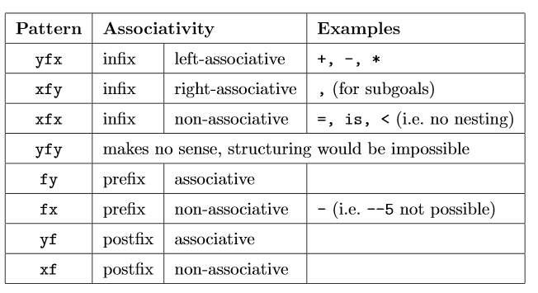
Pattern types:

Slide 7
Pattern types: (cont)
xfx, xfy or yfx meaning that the predicate is binary and is to be converted to an infix operator
fx or fy meaning that the predicate is unary and is to be converted to an prefix operator
xf or yf meaning that the predicate is unary and is to be converted to a postfix operator.

Slide 8
Operator examples:
Prolog Program:
is_female(noura).
owns(noura,fido).
isan_elephant(fido).
:-op(150,xfy,friend_of).
:-op(150,xf,is_female).
:-op(150,xf,isan_elephant).
:-op(150,xfy,owns).
sara friend_of X:- X is_female, X owns Y, Y isan_elephant

Slide 9
Operator examples: (Cont)
Queries:
?- sara friend_of noura.
true.
?- sara friend_of X.
X = noura.
?- X friend_of noura.
X = sara.
?- X friend_of Y.
X = sara,Y = noura.
?- is_female(X).
X = noura.

Slide 10
Operator examples: (Cont)
NOTE:
The rule sara friend_of X:- X is_female, X owns Y, Y isan_elephant IS EQUIVELANT of: friend_of(sara,X):- X is_female, X owns Y, Y isan_elephant
but if you write the second rule and then ask the first 4th questions in the previous slide that related of this relation, you must change the questions like:
?- friend_of (sara,noura).
?- friend_of (sara,X).
?- friend_of(X,noura).
?- friend_of(X,Y).

Slide 11
Operator examples: (Cont)
NOTE:
If you using the second style of rule and then don’t change the style of questions and then ask:
?- sara friend_of noura.
The SWI prolog answer:
Correct to: “friend_of(sara,noura)"?
Please answer 'y' or 'n'? yes
true.

